Slide 1
Basics to R Descriptive Statistics

Slide 2
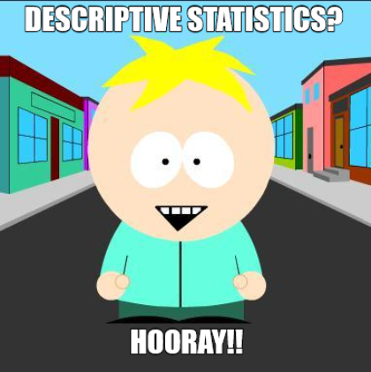
Outline for Today
What are descriptive statistics?
Why are they important?
What do I need to look at?
Using R for descriptive statistics and basic data visualization

Slide 3

What are descriptive statistics?
Simple summaries about the sample
Can be quantitative (e.g., the mean) or visual (e.g., histograms)
Common descriptive statistics:
Measures of central tendency: mean, mode, median
Measures of variability: standard deviation, variance, range, IQR
Modality
Skew
Kurtosis

Slide 4
What are descriptive statistics?
Statistics
Descriptive Statistics
Inferential Statistics

Slide 5
But why should I care?
Know thy data, know thyself
All inferential statistics are based on assumptions
If you’re data don’t meet the assumptions, then you’re conclusions may be false
Skew, kurtosis, variance, and distribution

Slide 6
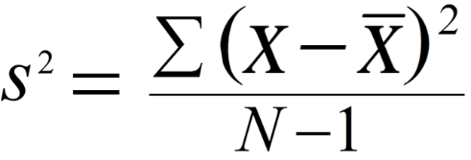
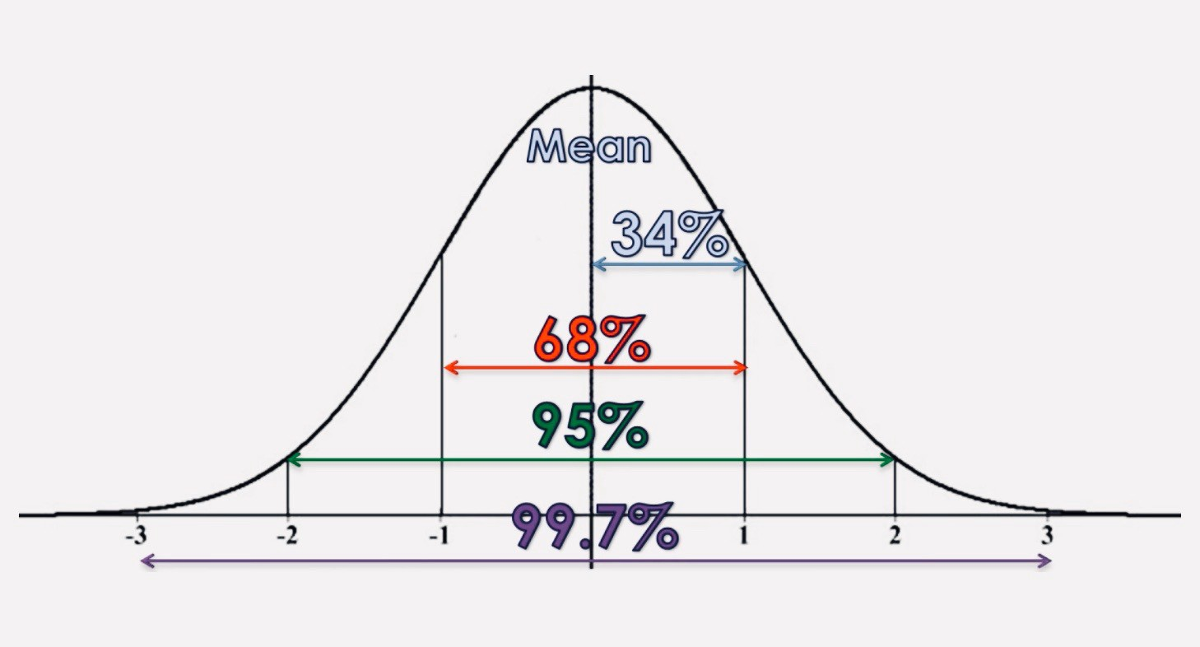
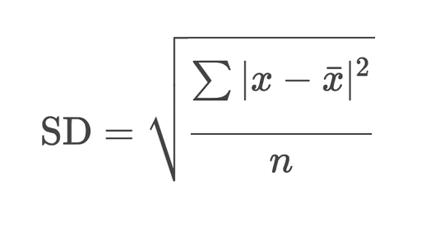
Variance
Standard Deviation

Slide 7
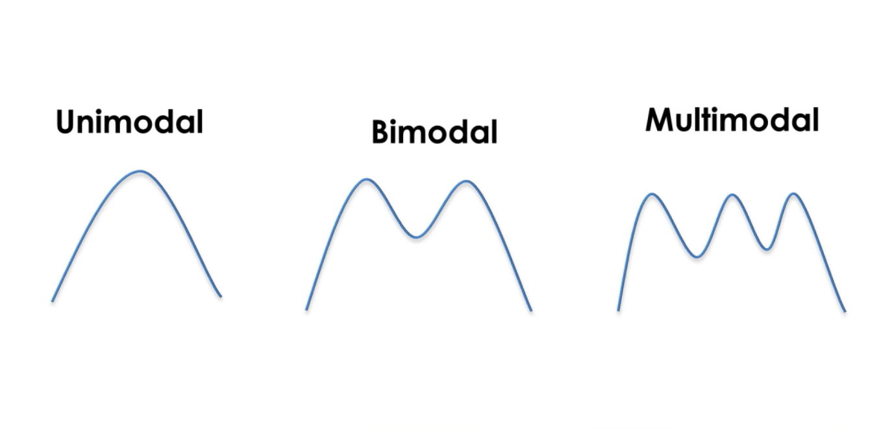

Slide 8
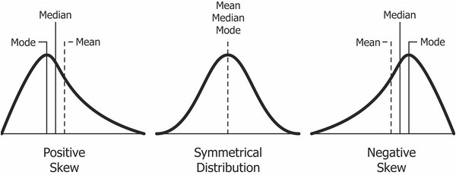
AKA The Dream Distribution

Slide 9
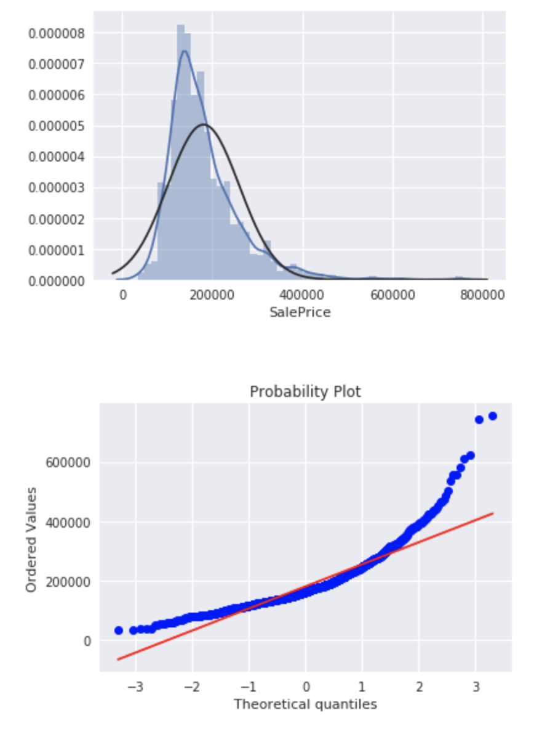

Slide 10

Summary
You need to get to know your data!
That requires looking at descriptive statistics
At a minimum, you should have an idea of the means, standard deviations, and shape of your data

